Slide 1
A survey of Optimal Transport for Computer Graphics and Computer Vision
Nicolas Bonneel and Julie Digne
CNRS, univ Lyon 1
Eurographics State of the Art Report 2023

Slide 2
Mathematician
Optimal Transport
Geometry Processing
Rendering
Image Processing
Simulation
AI fingers you wish optimal transport would fix

Slide 3
Applications to Image Processing

Slide 4
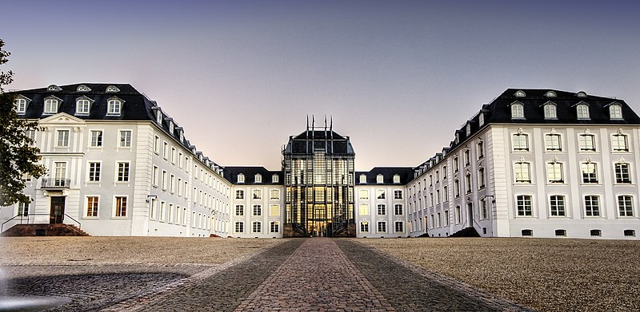
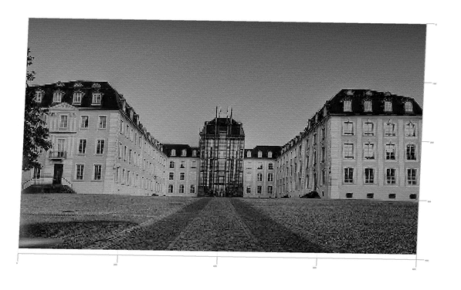
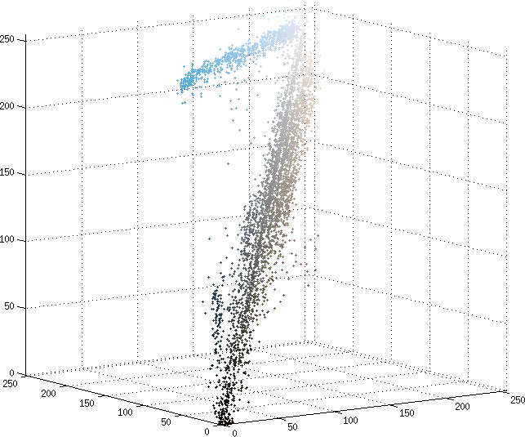
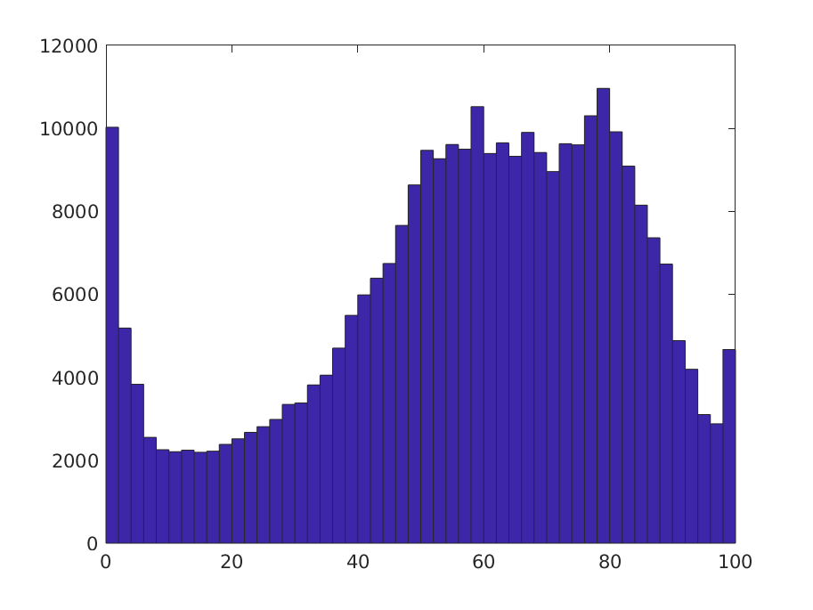
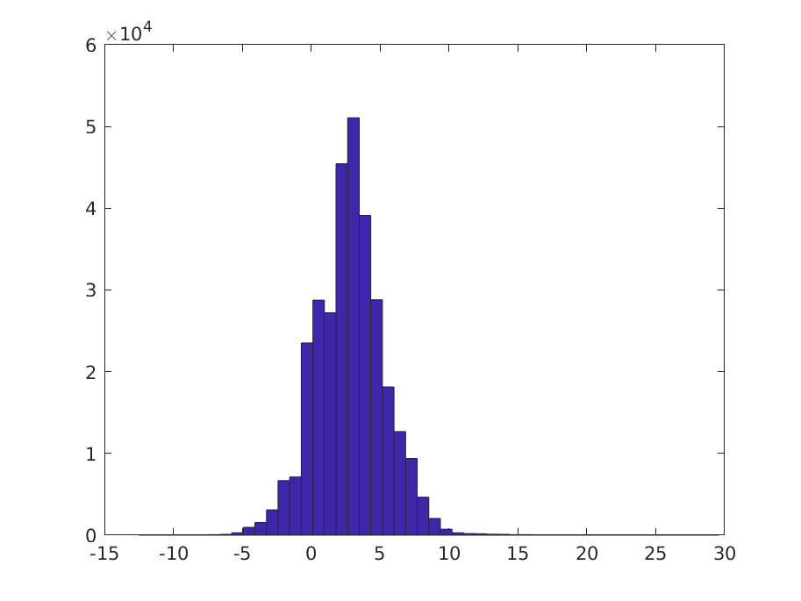
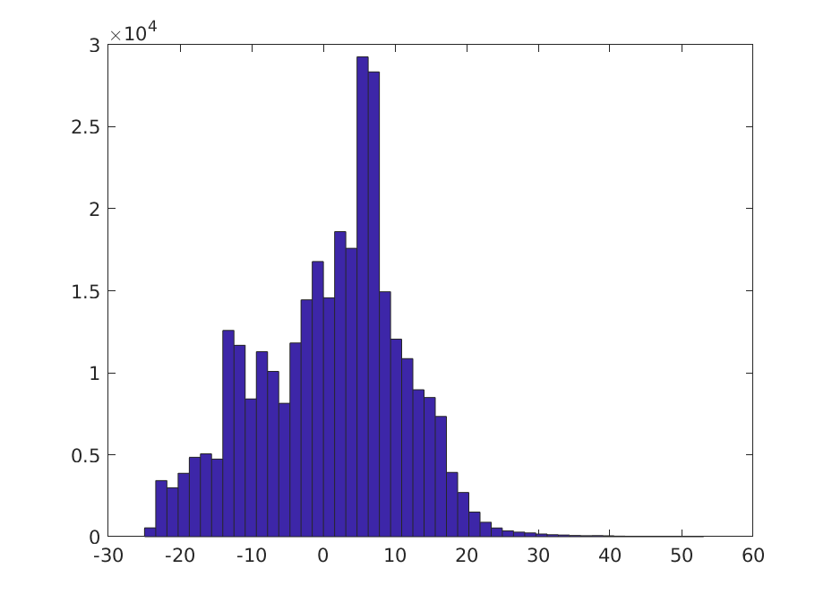
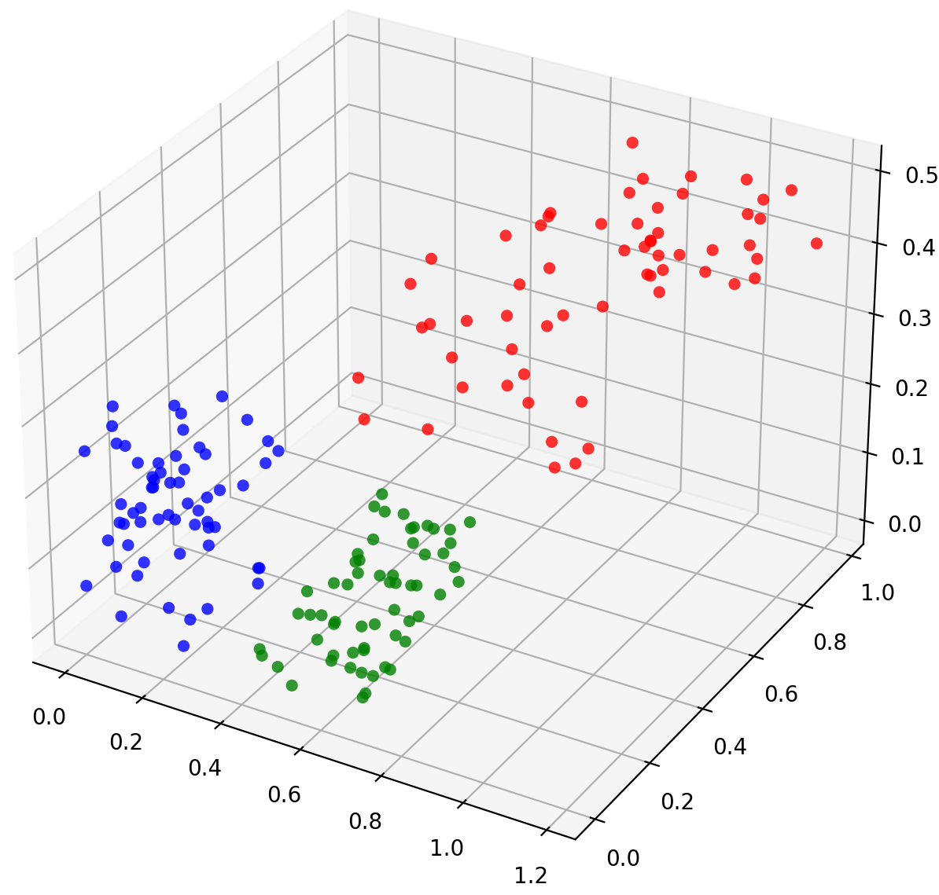
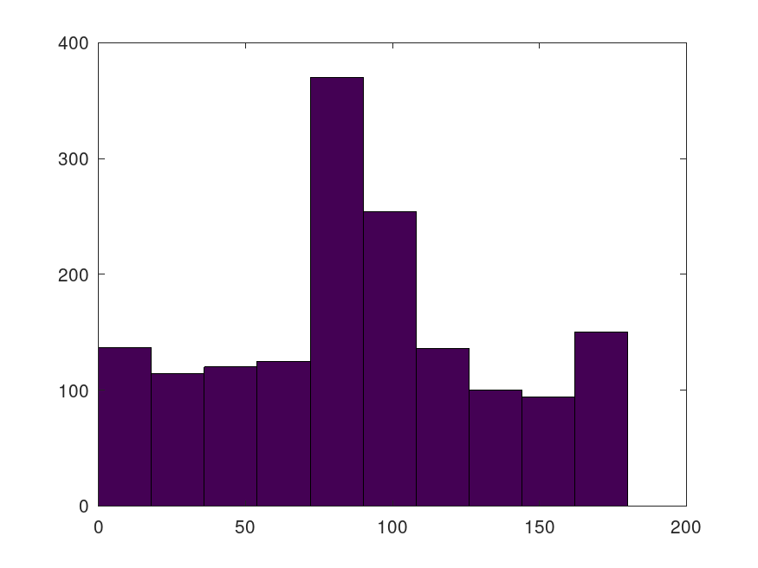
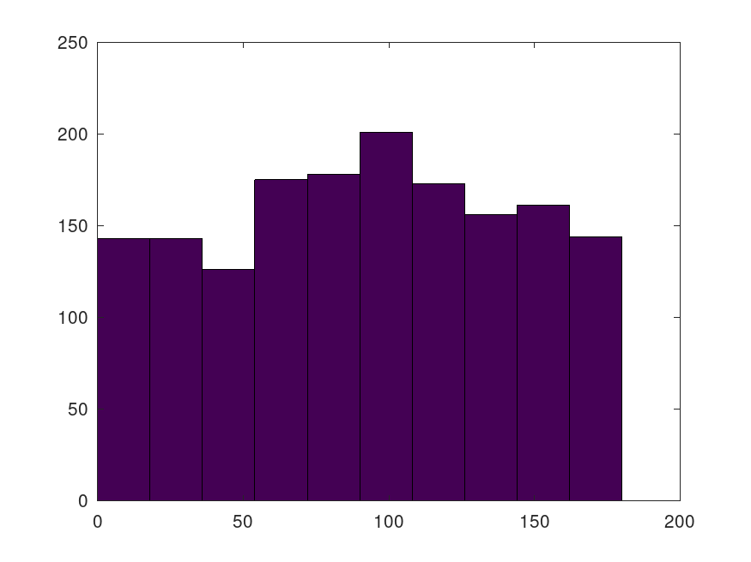
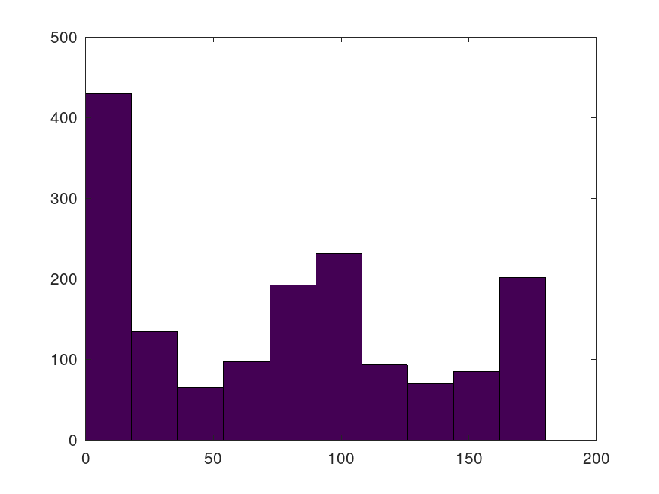
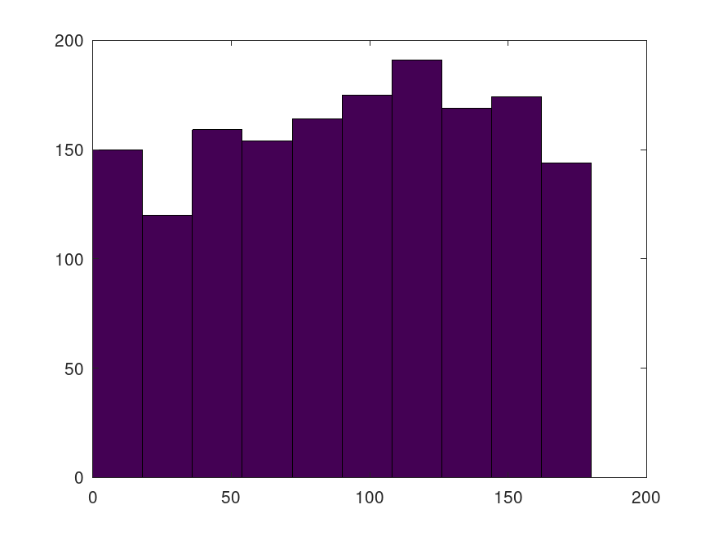
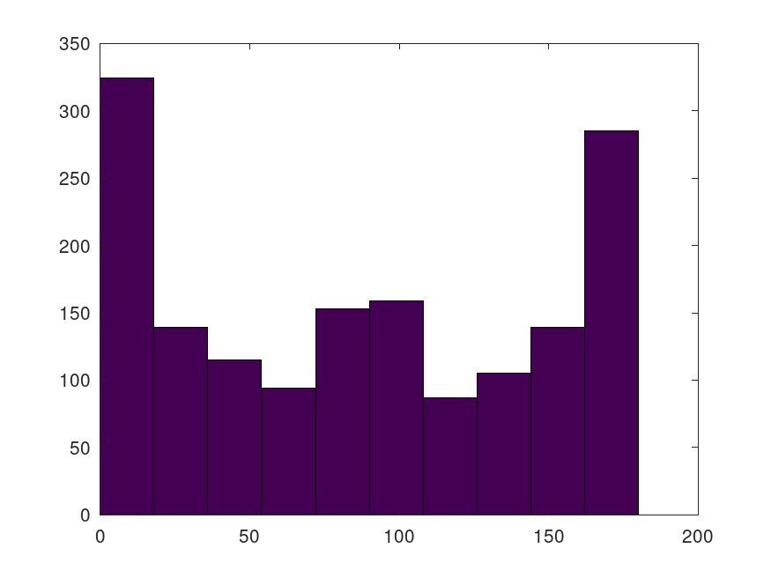
Applications to Image Processing
Image gray values as a distribution
Image color histogram as probability distributions
… Or as a distribution of features in feature space
or

Slide 5
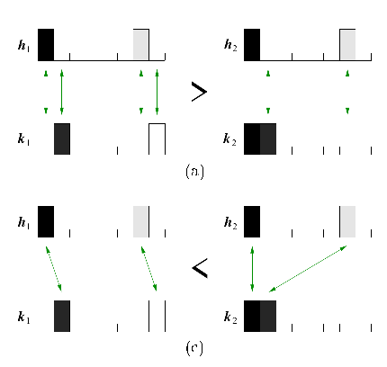
Applications to Image Processing Image retrieval
[Rubner 2000]
Features = Image colors in CIE-Lab [Rubner 2000]
Clustering in color space
Features = SIFT descriptors, shape contexts, spin images [Ling 07]
Improving solvers:
Unbalanced case [Pele 08]
Thresholding ground distances [Pele08,09]
[Rubner 2000]
Notes:
Nearest result to a picture of a red car in the database.
Unbalanced: still a metric

Slide 6
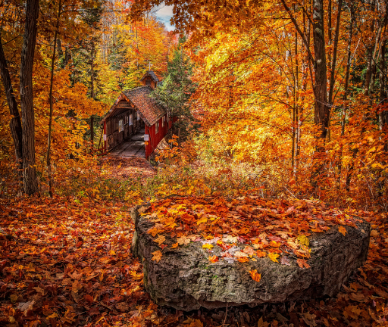
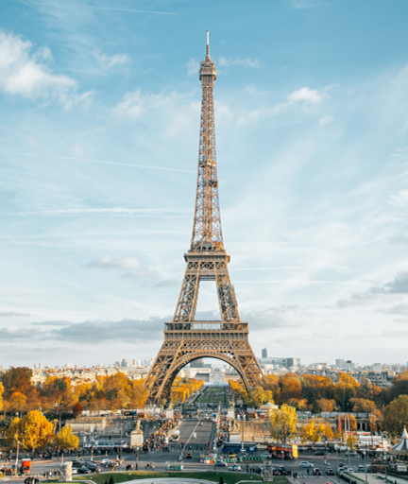
Applications to Image Processing Color Grading
Input photo
Target style

Slide 7
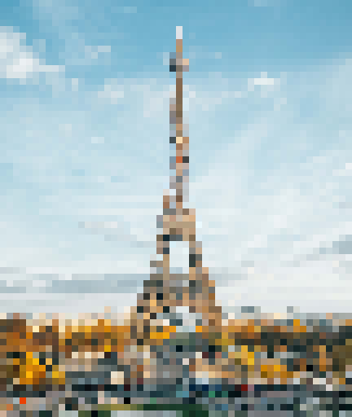
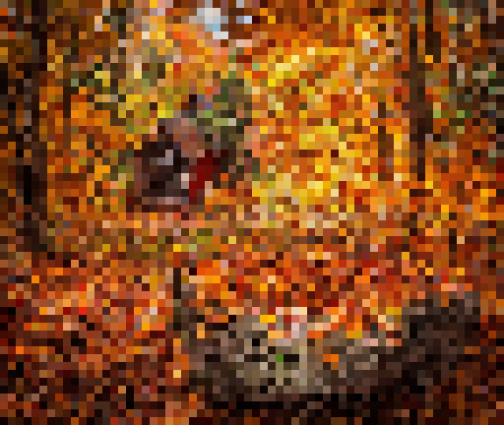
Input photo
Target style

Slide 8
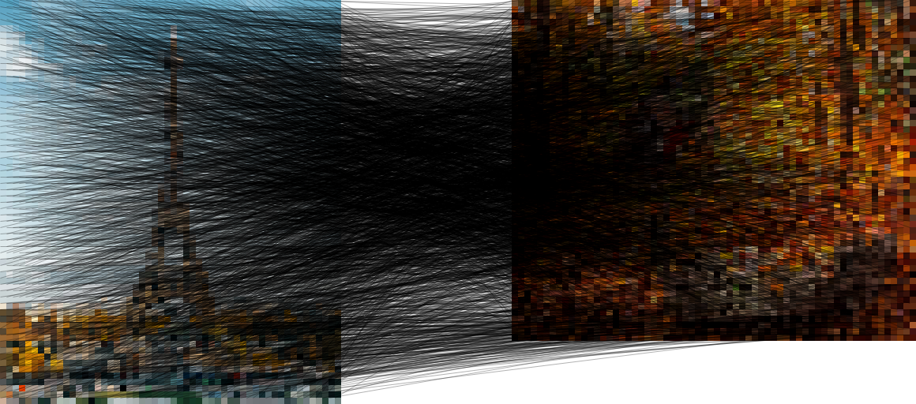
Input photo
Target style

Slide 9
Input photo
Target style

Slide 10
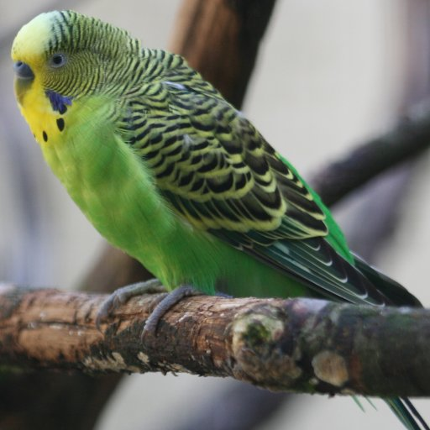
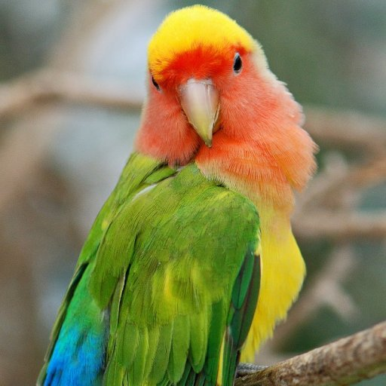
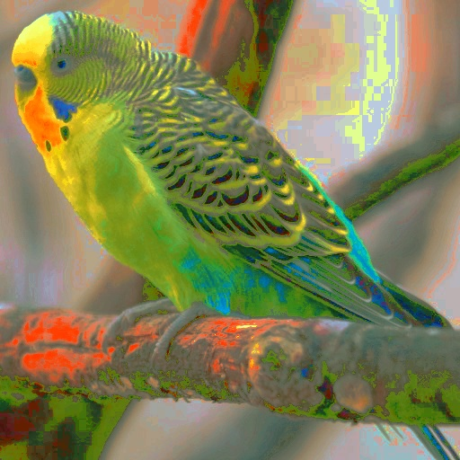
Applications to Image Processing Color Grading
Every Flavor of OT:
Sliced OT [Pitié 05, Bonneel 15]
Entropy regularized OT [Solomon 15]
LP solver on color clusters [Morovic 03, Bonneel 11, Rabin 15 ...]
Gaussian distributions [Pitié 07]
Color distribution in CIE-Lab = 1D OT for luminance, 2D for chrominance [Bonneel 13, Solomon 15]
Quantization artifacts [Rabin 10, Rabin 14, Chizat 18, Bonneel 19]
[Rabin 10]
Notes:
Color distribution = discretized on a grid or set of Dirac masses, or color clusters such as gmm
Matching color in case of transport plan: average
[Rabin 14] relaxed mass preservation constraints
[Pitié 07] variational formulation to force the image gradients towars the input image gradients

Slide 11
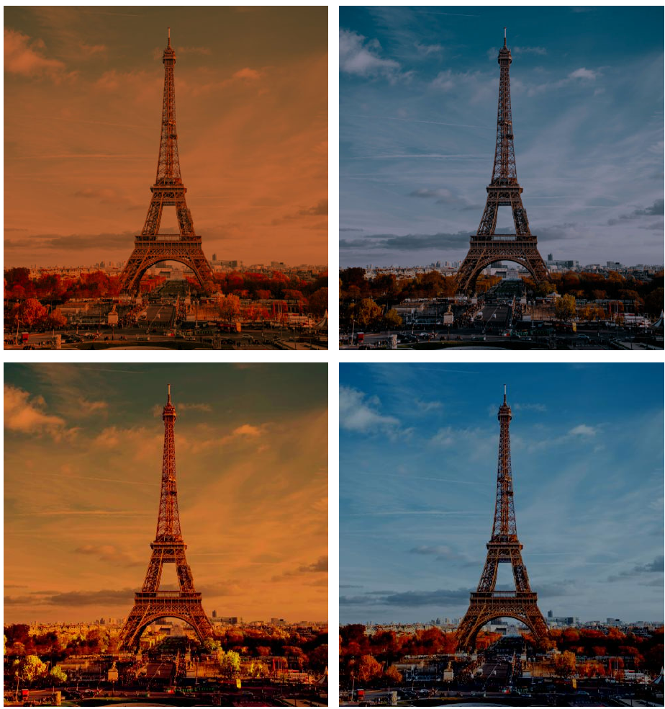
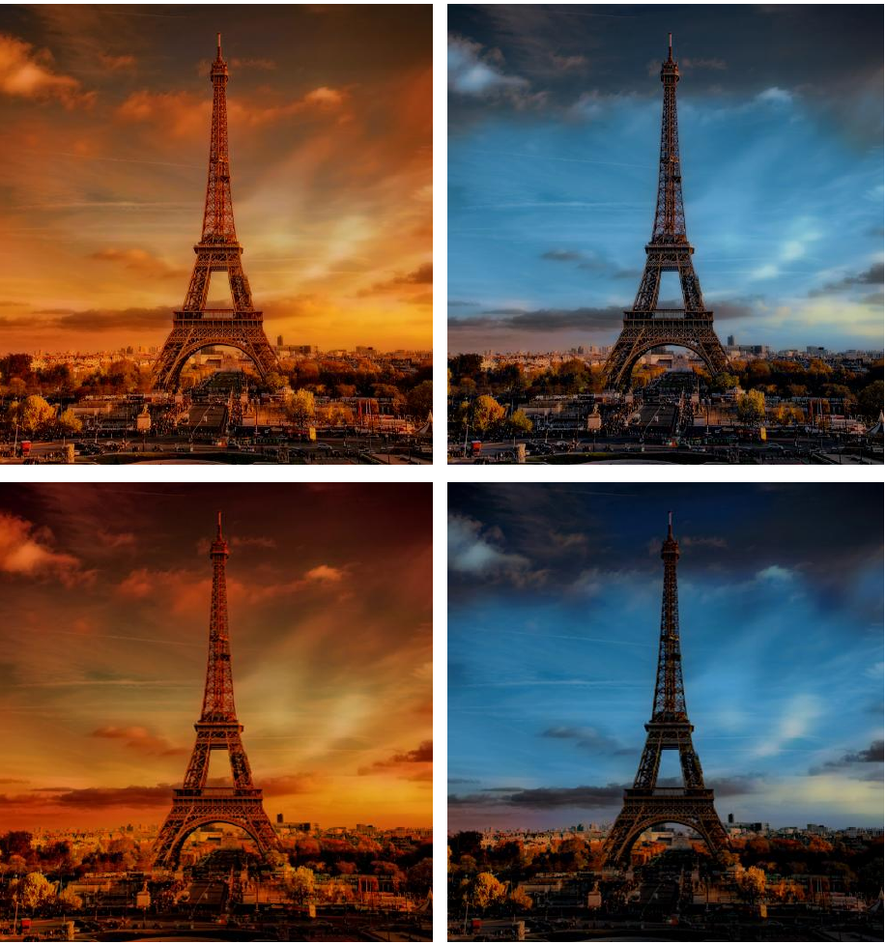
Applications to Image Processing Color Grading
Photoshop
Continuous sliced OT [Pitié 2007 b]
Gaussian OT
[Pitié 2007a}
Discrete sliced OT [Bonneel 15]
Notes:
all methods produce convincing results
quantitative perceptual evaluation of the color transformed images is challenging,
No perceptual studies were done.

Slide 12
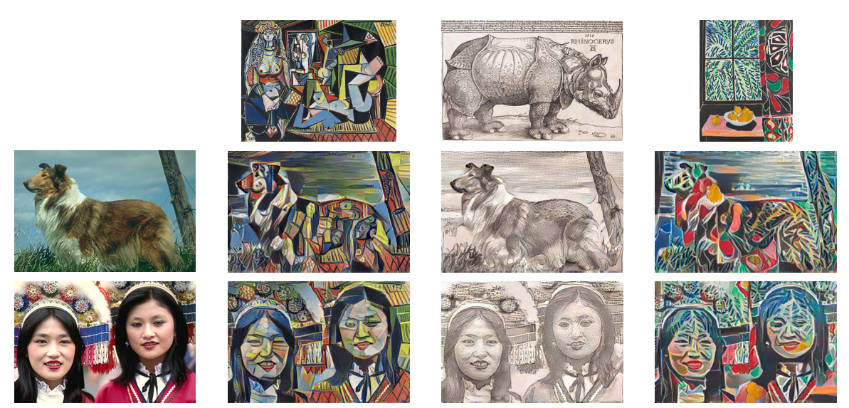
Applications to Image Processing Style Transfer
Style = usually Gram matrix of CNN features [Gatys 2016]
Instead, match CNN features with Relaxed OT [Kolkin 19] (sliced OT for texture synthesis [Heitz 21])
[Kolkin 19]
Notes:
Gatys: gradient descent to match the gram matrix
Kolkin 19: no mass preservation constraint more of a nearest neighbor problem.
Leclaire 21: continuous measure = Gaussian random field synthesized patches distribution; discrete measure = empirical distribution of the sample patches.
Leclaire 21: computing multiple restricted optimal transport problems between the source measure and a hierarchical simplification of the target measure, given by multi-resolution clustering.
Leclaire 21: A blending step mixes the style feature with geometric features of the source image.
Style trasnfer = Linked to texture synthesis as will be seen later

Slide 13
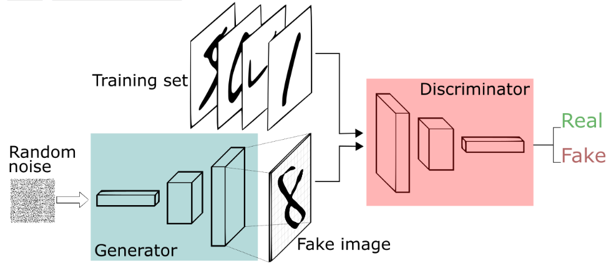
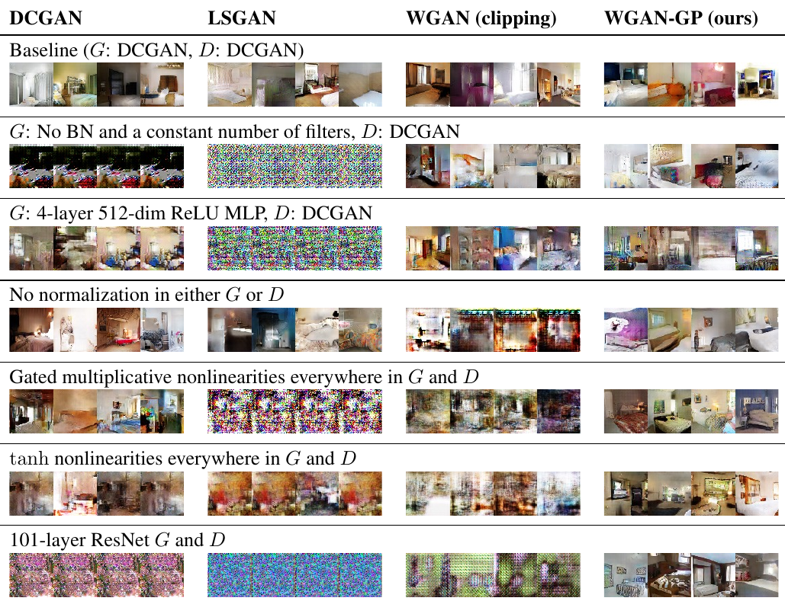
Applications to Image Processing Natural images generation
Generate images that look like an input set of images
Generative Adversarial Networks (GAN)
“Wasserstein GAN” [Arjovsky 17, Gulrajani 17, …]
[Gulrajani 17]
Notes:
WGAN: for a given G, weight clipping guarantees 1-lipschitz function (following Kantorovich Rubinstein)
Gulrajani: various architecture/hyperparameters change -> only their stable version converges for all sets of hyperparameters

Slide 14
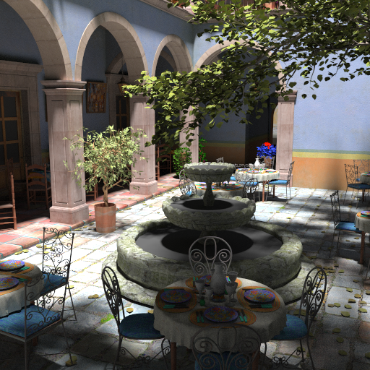
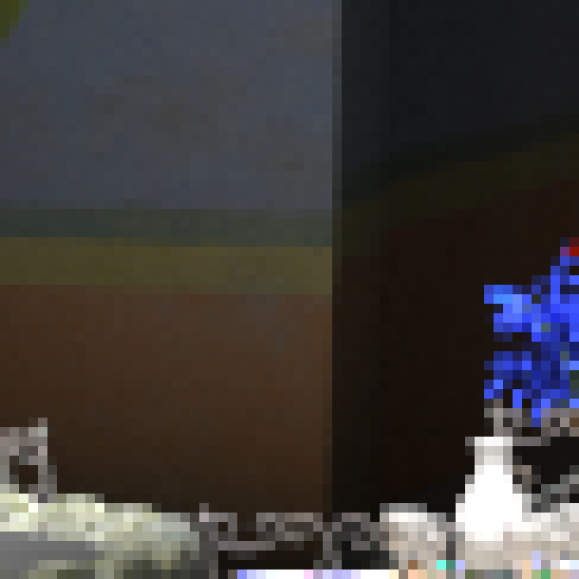
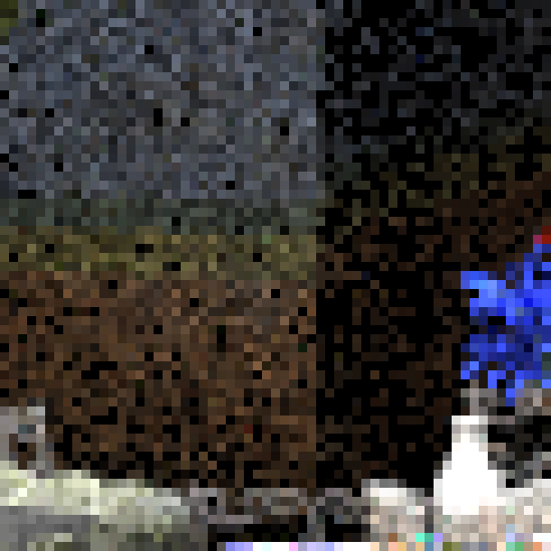
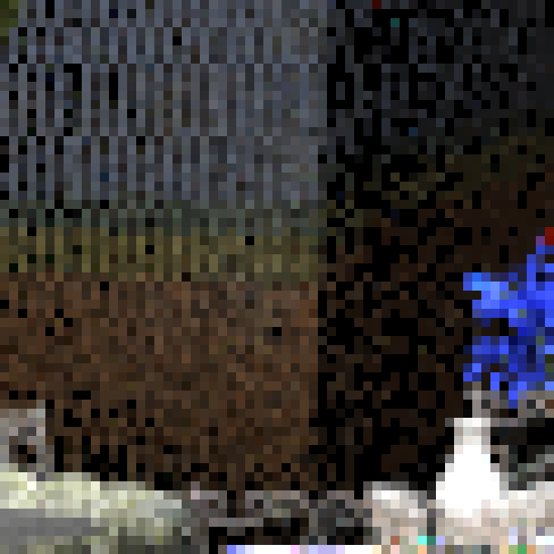
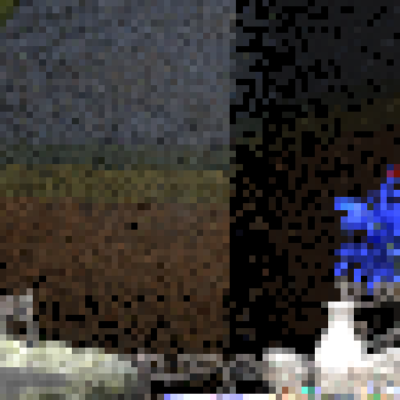
Applications to Rendering
ground truth
random
Sobol'
Sliced OT [Paulin 2020]

Slide 15
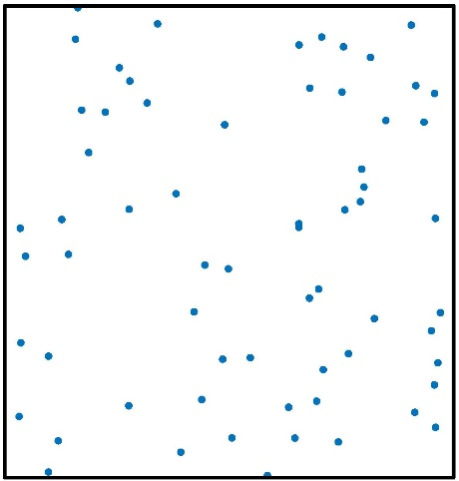
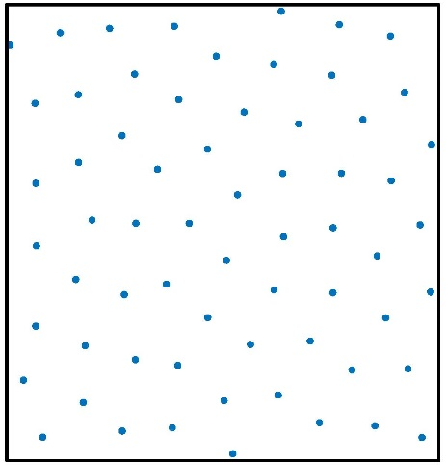
Applications to Rendering Image stippling & Monte Carlo sampling
Monte Carlo sampling
Numerical integral evaluation:
$$\int_{Ω}{f\left(x\right)dx≈\frac{1}{n}\sum_{i=1}^{n}{\frac{f(x_{i})}{p(x_{i})}}}$$ where $x_{i}$ follow law of probability density function $p$
When $p\left(x\right)=1$, converges faster when ${\left\{x_{i}\right\}}_{i}$ are not i.i.d. but blue noise

Slide 16
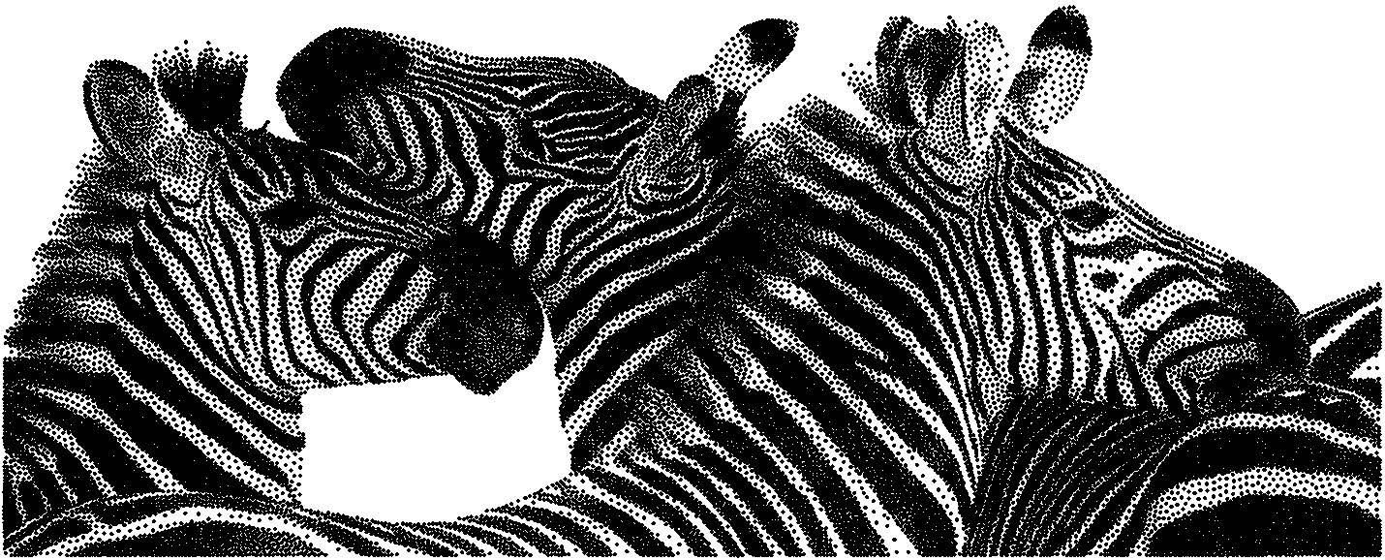
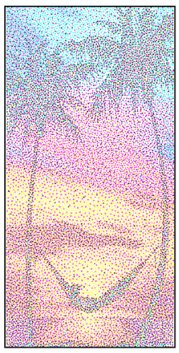
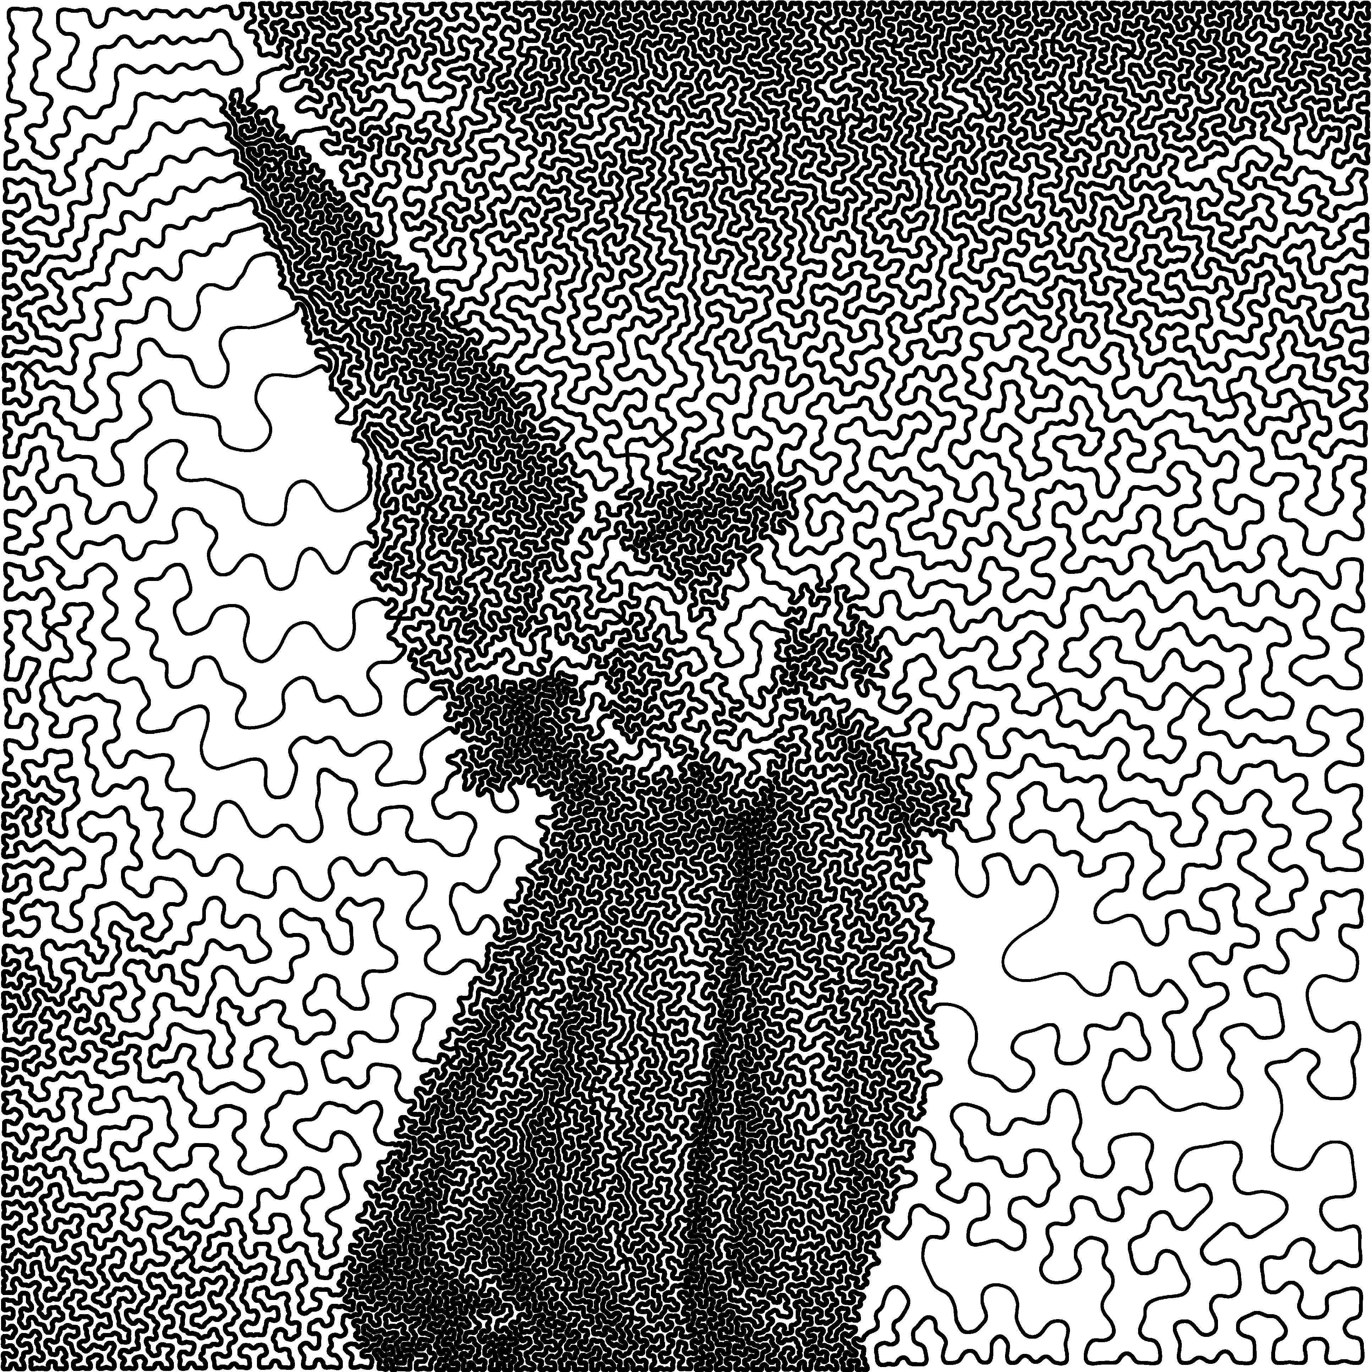
Applications to Rendering Image stippling & Monte Carlo sampling
Image stippling
Considers grayscale image = probability density function
For artistic purpose, and for printing with black ink droplets
Extends to colors [Salaün 2022], curves [Lebrat 2019]
"BNOT" (Blue Noise Through Optimal Transport), [De Goes 2012]
[Salaün 2022]
[Lebrat 2019]

Slide 17
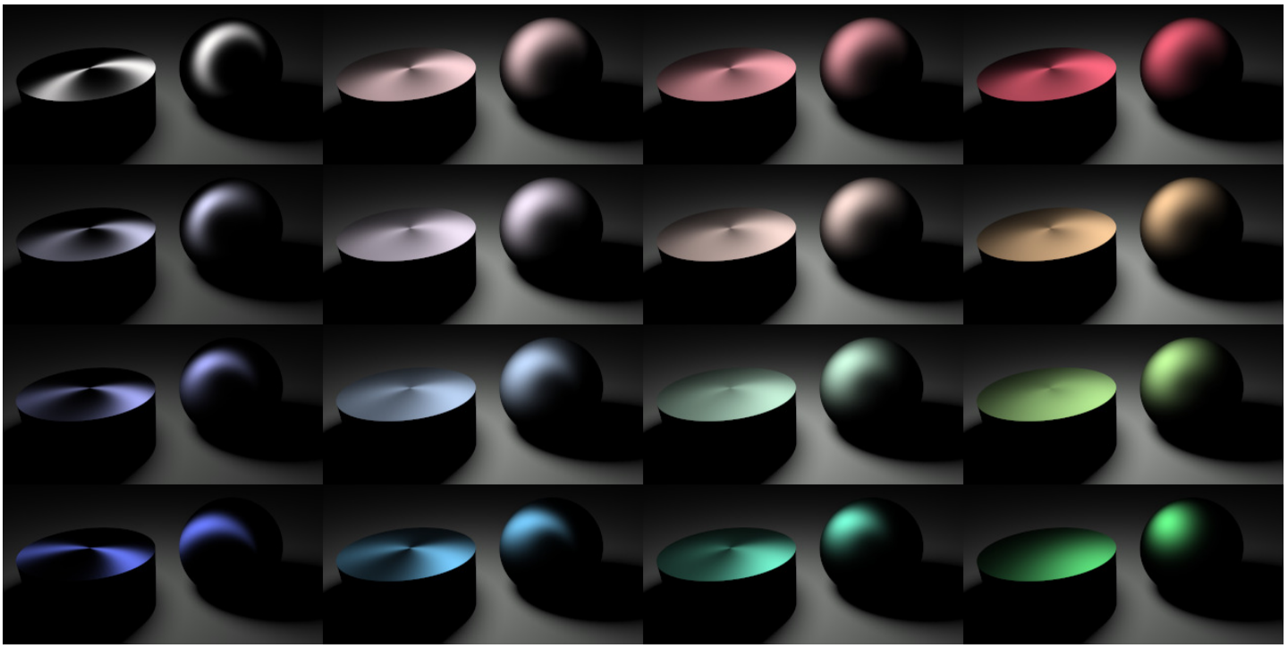
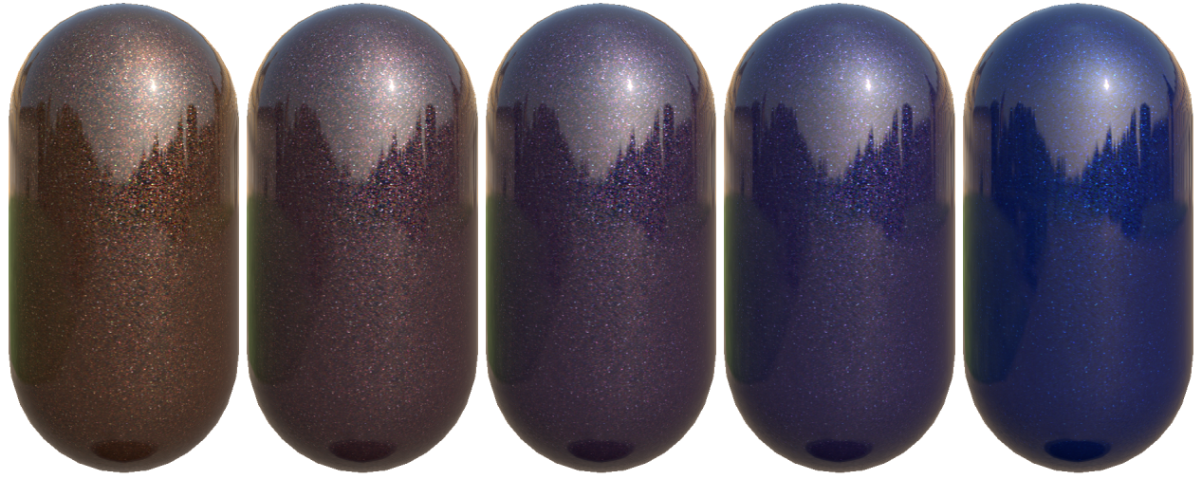
Applications to Rendering Reflectance manipulation
Interpolating between different BRDFs
2 BRDFs [Bonneel 2009]
n BRDFs [Solomon 2015]
n car paint BTFs [Golla and Klein 2018] (flakes interpolation)
Densifying sparse BRDFs
By interpolating between incident directions [Ward 2014]
By projecting on dataset of dense BRDFs [Bonneel 2016]
OT between BRDF degradations correlate with perception [Lavoué 2021]

Slide 18
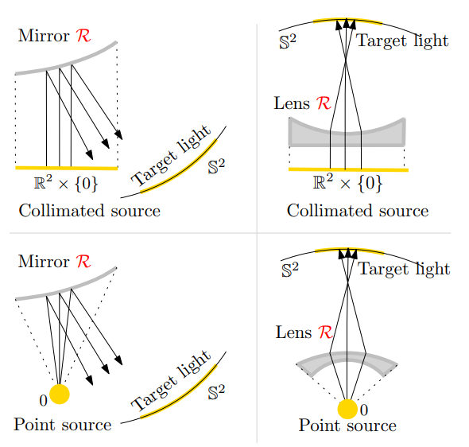
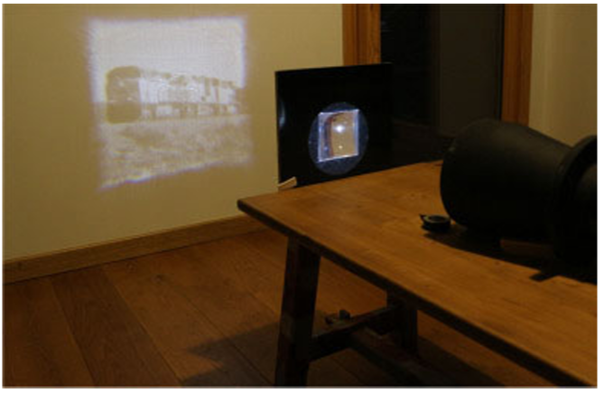
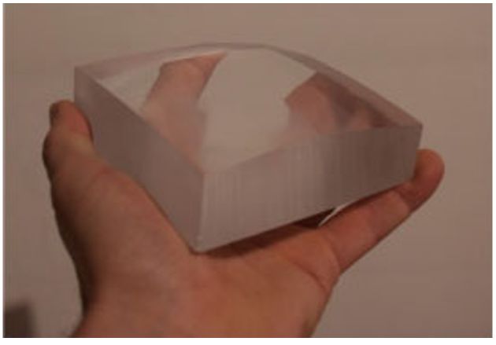
Applications to Rendering Computational optics and imaging
Transporting light distribution to given target (mirrors or refractors)
Semi-discrete OT for general problems [Meyron 2018]
Refractor/reflector, near/far-field, collimated/punctual light source, concave/convex surfaces… in the same framework
Amount to standard semi-discrete OT with $c\left(x,y\right)={\left\|x−y\right\|}^{2}$
(up to changes of variables)
Uses a set of parabolas

Slide 19
Applications to Geometry Processing

Slide 20
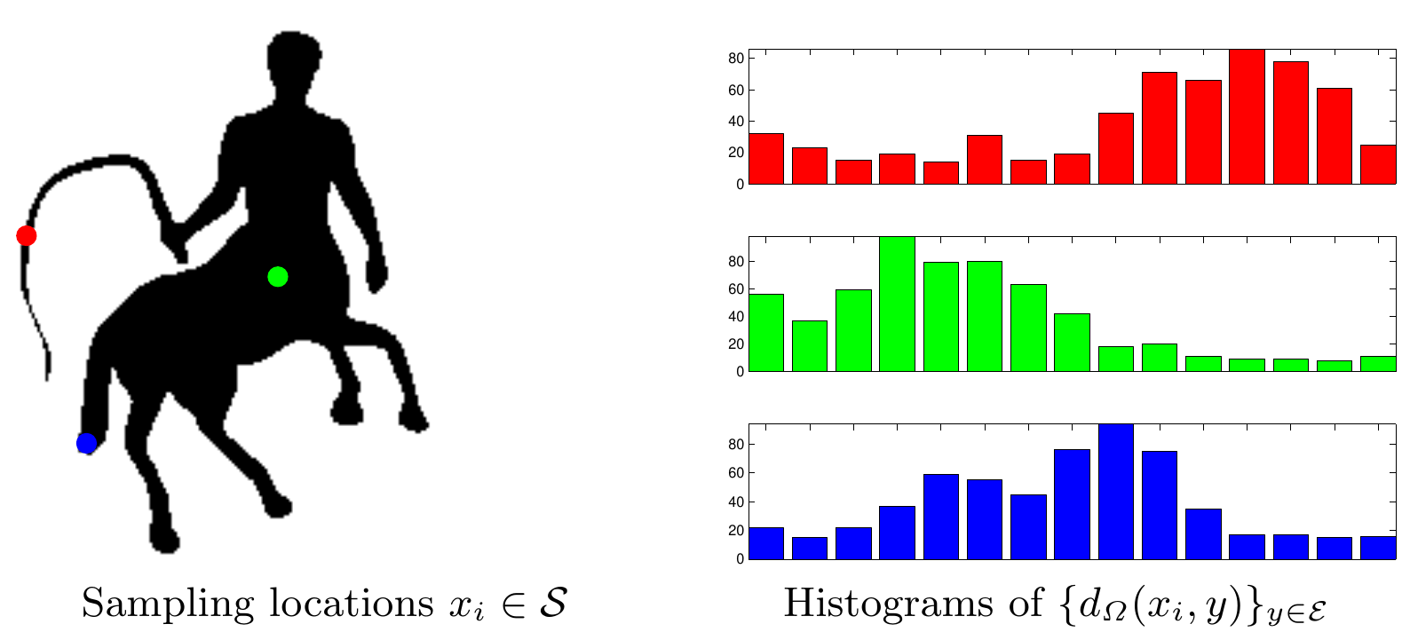
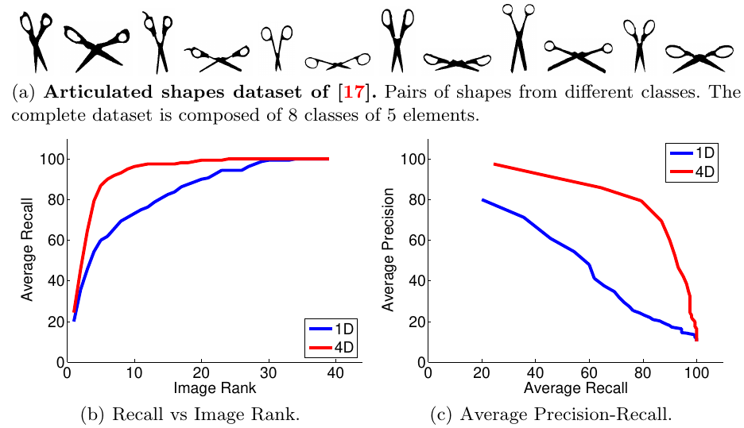
Applications to Geometry Processing Shape comparison and retrieval
Shapes as a bag of descriptor
Descriptor: Geodesic distances to a set of anchor points [Rabin 10]
Sliced Wasserstein 2 as a distance metric between the descriptors.
[Rabin 10]
[Rabin 10]
Notes:
Lipman 09,11: ground distance invariant to Möbius coordinate changes
Lipman 09,11: Domain discretization
Rabin: farthest point sampling of the shape + sets of histograms
Geodesics distances -> robust to isometric deformation
Instead of geodesic distances -> use quantiles (minimum, median, maximum=eccentricity and mean in some cases) 1D= eccentricity only
Sliced wasserstein 2

Slide 21
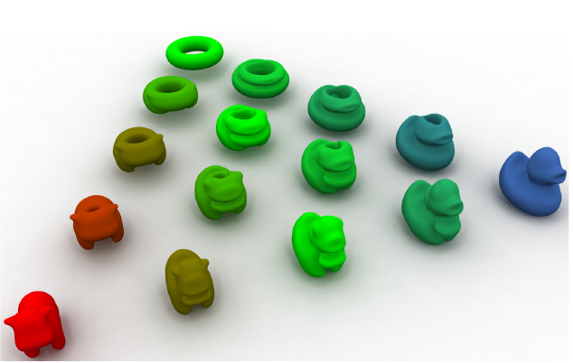
Applications to Geometry Processing Shape interpolation
[Rabin 12]
2D or 3D shapes for which feature matching is impossible
Discretizing the volume as point sets+ sliced Wasserstein [Rabin 12]
Points sampled in the volume
Semi-discrete OT to interpolate between two tetrahedral meshes [Lévy 15]
Recovers a topology throughout the interpolation
Alternative to sampling: shapes = indicator functions discretized on grids (2d or 3d)
Fast convolutional Wasserstein Distances [Solomon 15]
[Lévy 15]
[Solomon 15]
OT-based shape interpolation: well defined but still some topological issues, mass may split, connected components appear and disappear.
Notes:
No feature or repeated features -> error prone matching
Rabin 12:
Top row: sliced wasserstein, bottom wasserstein 600 points
H_k hessian of E (Morre-Penrose pseudo inverse)
Y_theta^j projection of the jth point cloud on direction theta (J point clouds to compute barycenter from).
Sample M' with a set Y of k points
Compute semi-discrete OT between Y and M as a power diagram, get dual triangulation T
Extract correspondence between T and
Find common triangles to get the topology
Interpolate linearly the vertices positions

Slide 22
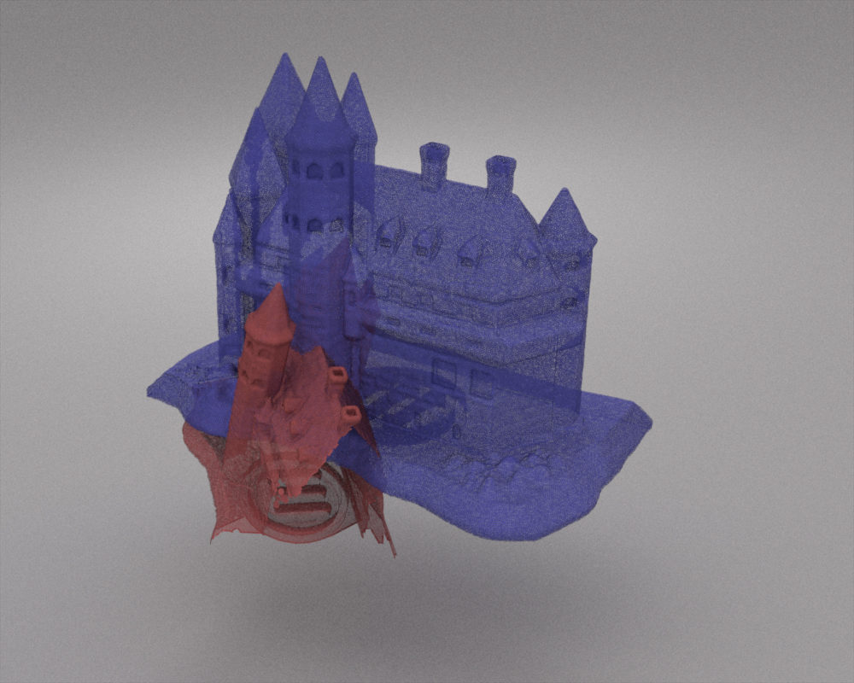
Applications to Geometry Processing Shape registration (point cloud to point cloud)
Matching partial point clouds using sliced Optimal Transportation [Bonneel 19]
Injectivity is guaranteed
ICP variant
Source: 150k samples Target: 200k samples
ICP (0.09 s / iteration)
[Bonneel 19] (2.18 s / iteration)
Notes:
OT -> matching data-> natural way to look for reliable and consistent
Issue: partial shape matching
Bonneel 19 -> injectivity is preserved (!= closest point) no other guarantee (not the unbalanced OT à la Vialard)
Shen 21: soft KL -> will allow partial matching
Li 21: ground distance accounting for differences in point positions, colors and normals

Slide 23
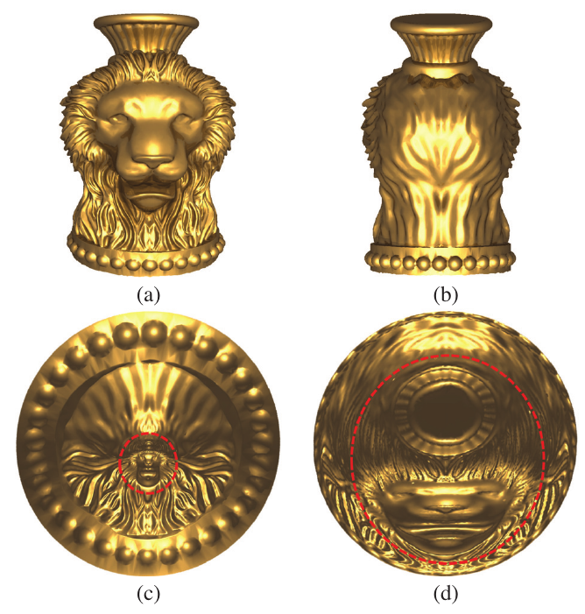
Applications to Geometry Processing Shape Parameterization
Parameterization = Unfolding a mesh on a planar/spherical domain
Conformal mapping preserves angles but large area distortion
Area distortion of this parameterization = density
OT between and a uniform density
Combination of conformal mapping + OT map = area preservation mapping
[Dominitz 09]: solved using a gradient flow
[Zhao 13]: solved using semi-discrete OT
[Zhao 13]
Notes:
Importance for texture mapping
Dominitz 09 : param on a sphere
Zhao: Vertices are given the average of the areas of their neighboring triangles as weights - uv coordinates are moved to the centroid of their power cells.

Slide 24
Application to simulation and animation

Slide 25
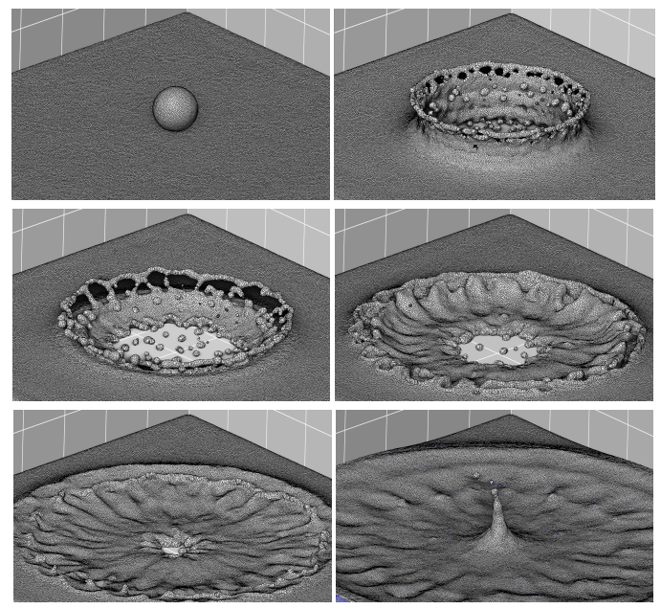
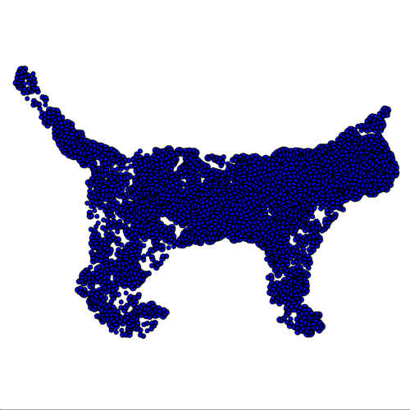
Applications to simulation and animation
Fluid simulation
Incompressible Euler equations = flow under a volume preserving map
Fluid at any state = warping of a uniform density under area preserving map
Recover incompressibility using optimal transport
Particle-based approach: apply forces, advect, projection with OT
Projection with OT = Semi-discrete OT between particles and uniform density [Gallouët and Mérigot 2018]
Partial semi-discrete OT for free boundary fluids [Lévy 2022]
Semi-discrete entropy-regularized transport [Qu 2022]
Move particles towards the barycenter of their cell
Notes:
Henderson19: 1d transport
Cosmology: displacement interpolation between unifrom density (universe at t=0) and current distribution of mass in the universe
Relaxed EMD = [Kusner 15] dropping mass conservation and applying it in the two directions + maximum
The Gene Mover’s Distance [BCG∗ 21] similarity between two cells by computing an EMD with a ground distance = ℓ2 distance in a 200-dimensional euclidean embedding of genes.

Slide 26
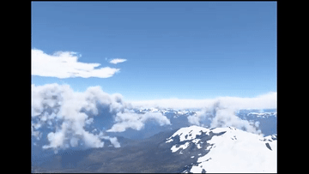
Applications to simulation and animation
Animation
Wasserstein barycenters (with Sinkhorn divergence) to interpolate between animation keyframes [Zhang 2022]
Linear program OT to interpolate between cloud keyframes [Webanck 2018]
Entropy-regularized barycenters to interpolate plant point clouds [Golla 2020]
OT barycenters as a way to parameterized shapes for swimmers [Ma 2021]
Notes:
Gazdieva: MSE cost for c(x,y) or perceptual cost between VGG features (combines MSE between result and upsampled input and MSE between VGG features of upsampled input and result).

Slide 27
Discussion & Conclusion
Many applications of OT in particular for interpolation
May not preserve topology
Not always meaningful (e.g., for direct image warping)
If input data ≠ probability distribution
How do we cast data as a probability distribution?
Many results are superseded by Deep Learning
But the optimization tools are still useful even for Deep Learning
Remaining problem: scalability
Many fast algorithms but still slow for millions of variable

